Slide 1

Getting productions back to business

Slide 2
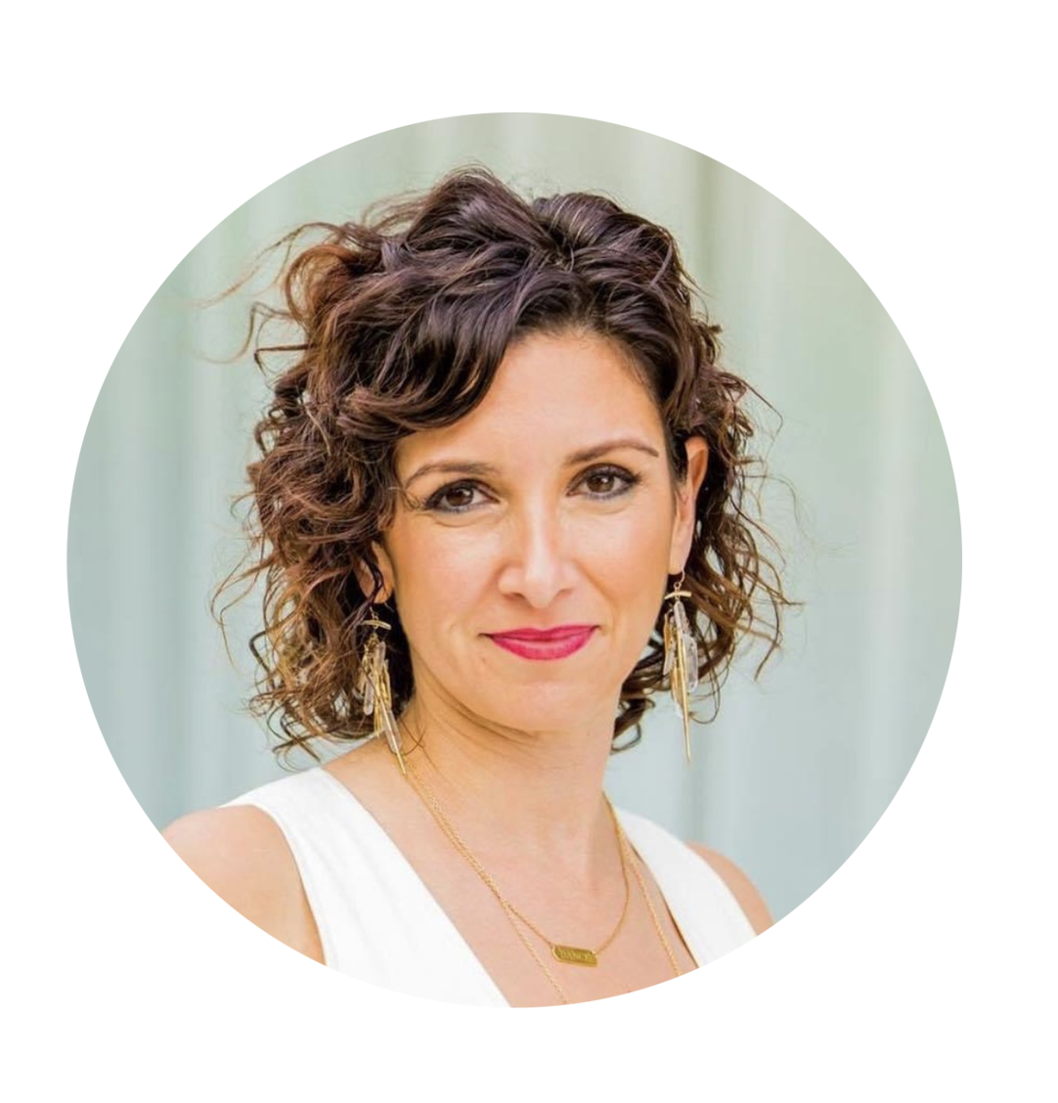
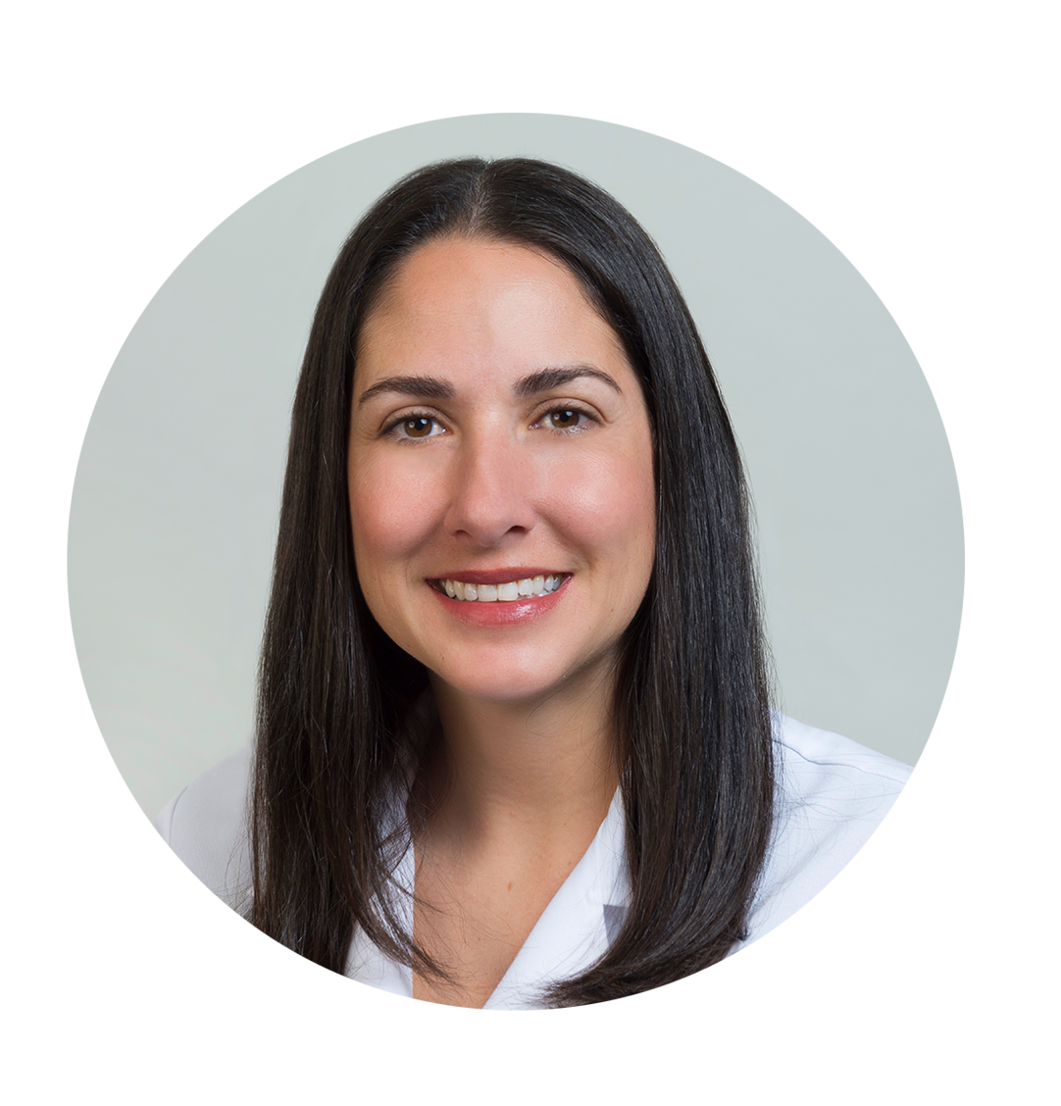
Who we are:
Naomi Dabby
Lisa Dabby
Undergrad: UC Berkeley, BS Chemistry, BA Molecular Cell Biology, Genetics
Medical School: USC Keck School of Medicine, Doctor of Medicine
Internship: Harbor-UCLA Medical Center
Residency: Albert Einstein College of Medicine Emergency Medicine Residency at Jacobi/Montefiore Medical Centers
Certification: American Board of Emergency Medicine
Contact: naomi@modmd.org
Undergrad: UC Berkeley, BA in Molecular & Cell Biology
Medical School: University of California, San Francisco, School of Medicine Doctor of Medicine with Thesis
Internship & Residency: Harbor-UCLA Medical Center
Certifications: American Board of Emergency Medicine
Contact: lisa@modmd.org

Slide 3
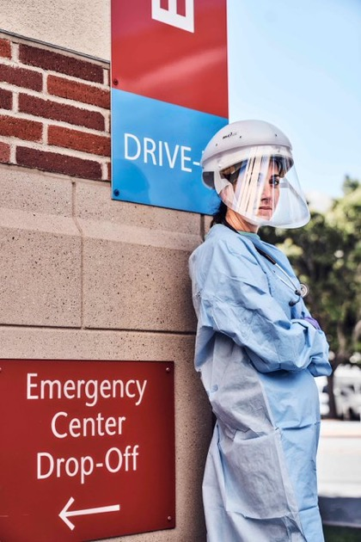
Who we are (cont.):
We are board certified emergency medicine doctors with over 20 years of experience each.
Dr. Lisa Dabby is a recognized expert, featured in the LA Times, LA Magazine, and on CNN
Dr. Naomi Dabby has been caring for critical covid patients in the Covid Surge Hospital ICU
We are taking care of covid patients in the emergency room
We have consulted for an independent production
We have created modMD to bring excellent care and safety to your production site.

Slide 4



What modMD offers productions:
Large volume rapid Covid-19 testing on site
Education & safety protocols for staff
Qualified Safety monitor on location

Slide 5
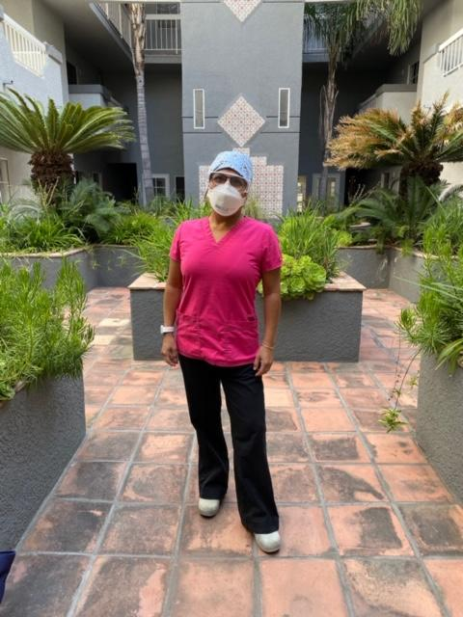
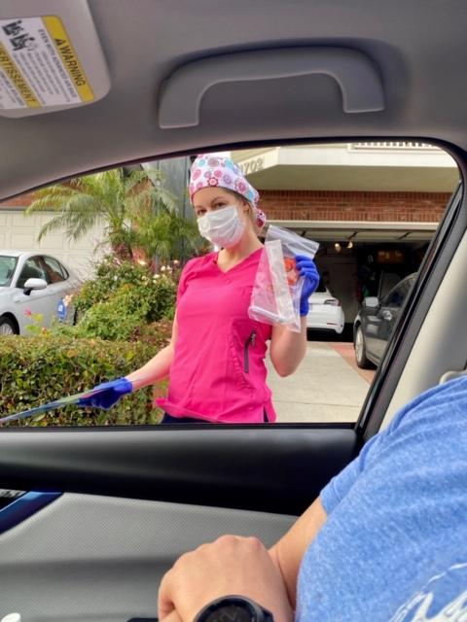
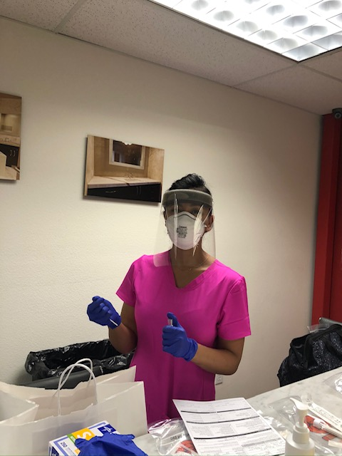
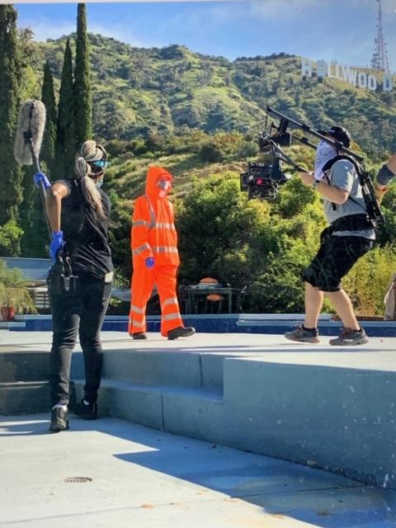
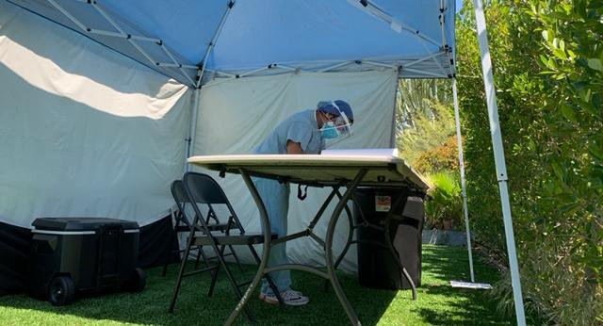
What modMD offers productions:

Slide 6
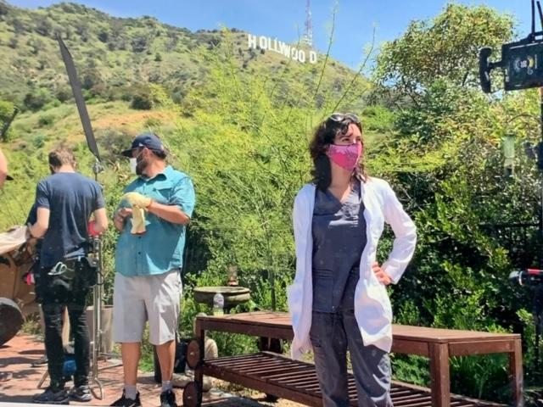
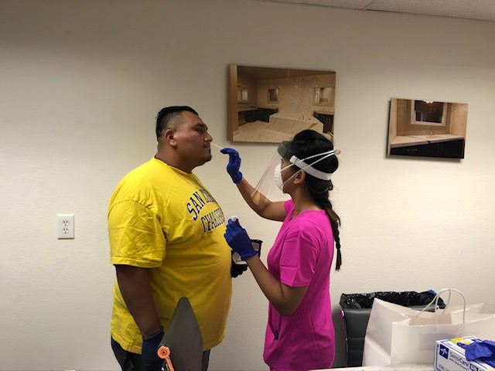
Testing:
We are HIPAA compliant
We can run up to 400 tests per day at the site of your business with a turnaround time of 24 hours.

Slide 7
Education & Safety Protocols
Our goal is to help your production get back to work safely.
We help create safety protocols for your production
We can tailor individual guidance to each crew member’s role (ex camera man, lighting, make-up, and talent) to improve their safety.
We can provide training to all employees regarding covid, protective equipment, hygiene, and best safety practices
Specialized counseling for high risk employees
Qualified safety monitor on-site

Slide 8
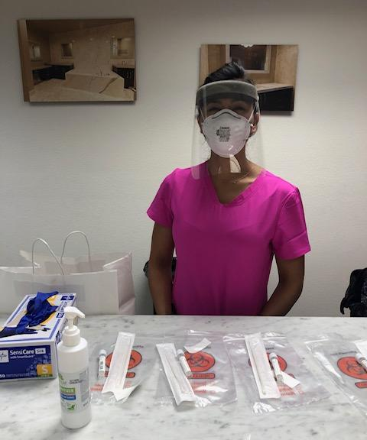

Our Staff:
We use registered nurses who are experienced in administering Covid-19 tests and will be wearing full medical grade personal protective equipment.
We have a safe practice checklist to keep you and your employees protected during the testing.

Slide 9
Testing Logistics
We can offer full-service logistic planning for your company’s testing procedure:
-Scout proposed testing site to ensure proper set-up and safety
-Provide tents and infrastructure for outdoor test sites
-Offer custom scheduling software to efficiently process testing for large groups
-Intake and processing administration staff
-Cleaning and sanitization crew
These services can be customized to accommodate your test site and group needs.

Slide 10

How HollPass keeps productions safe + private
1
HollPass™ daily SMS symptoms tracker, using cryptographic privacy
eco-system, interoperable with vendors, labs, doctors, employees
2
Testing (incl antibodies). On-site sample collection and maintenance throughout production
3
Non-invasive SMS-based contact tracing with A.I. optimization. Work with each production to map out movements and buildings, create QR ‘keys’

Slide 11
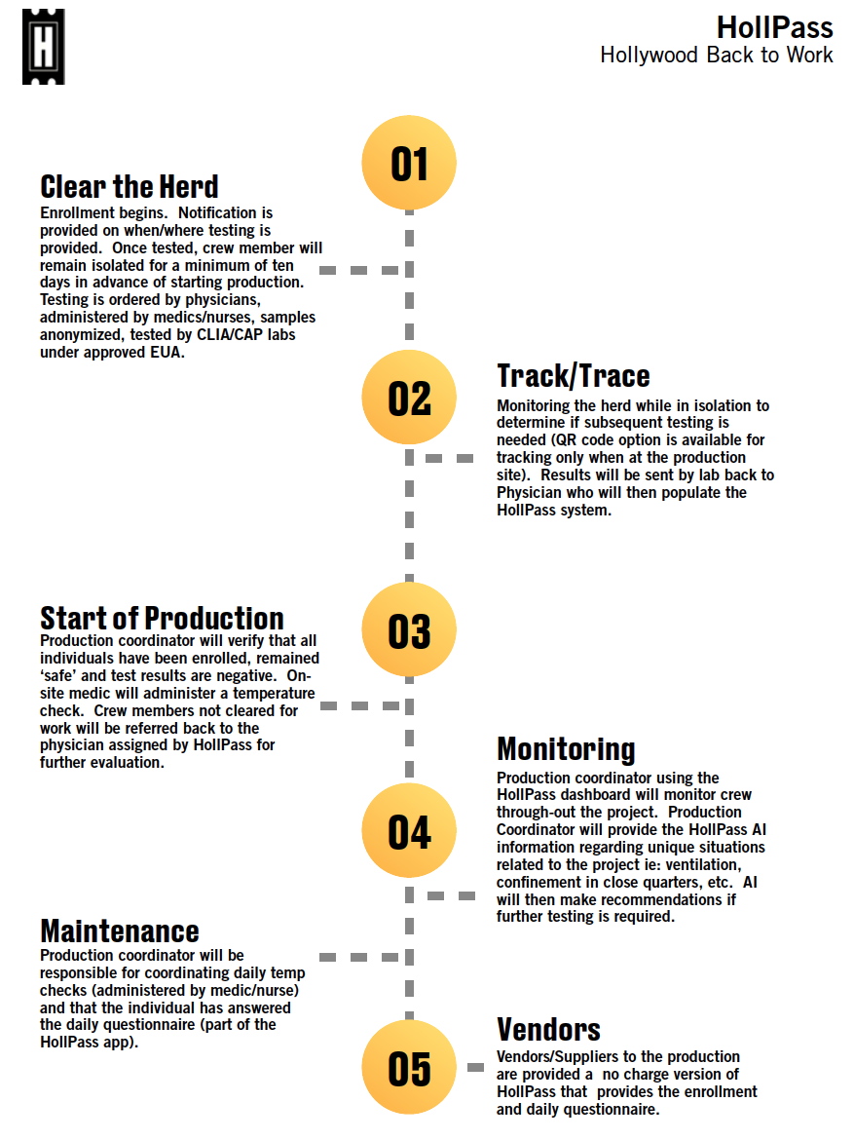
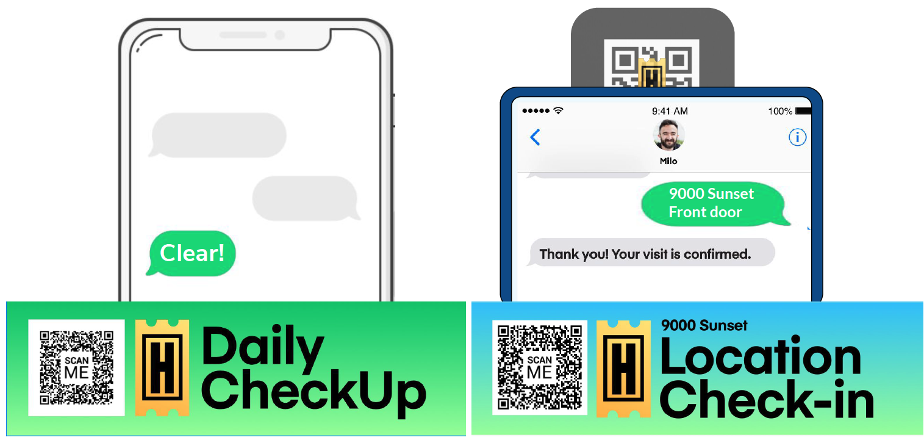
HollPass Instant and Easy

Slide 12
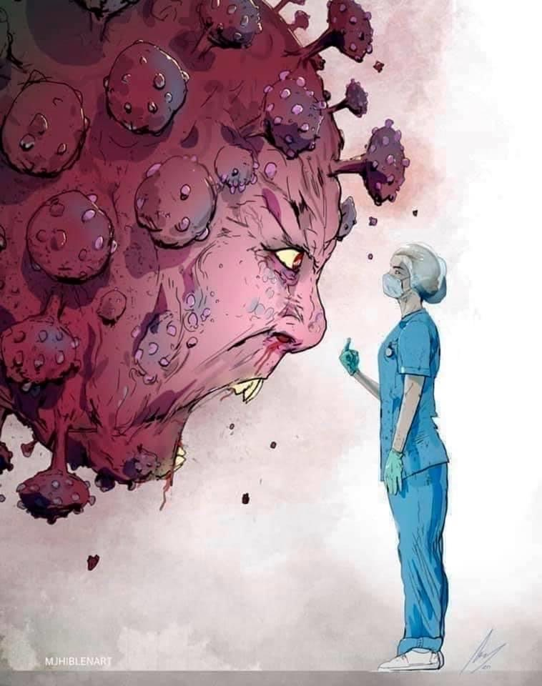
Thank you

